Slide 1

Austrian EMN conference 2022
Case of Pakistan
Muhammad Amad
Azmat Khan

Slide 2
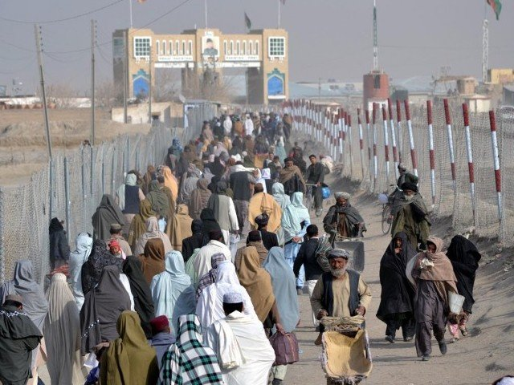
Refugees Info
Historically Pakistan had been hosting more than 4 Million Afghan refugees in addition to a significant number of undocumented Afghans
Registered Afghan Refugees in Pakistan 1,435,026.
Overall 4,382,019 refugees have voluntarily repatriated to Afghanistan since 2002 to Afghanistan.
Majority of the refugees population living in hosting communities

Slide 3
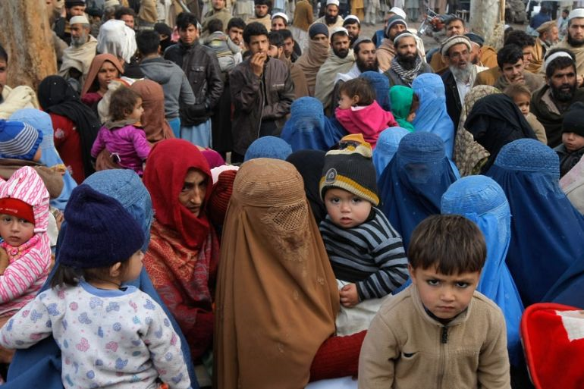
Defining the challenges
Own Population
Dependence on Natural Resources
Low performing economy
Increasing rent of housing both for local population as well as refugees
Law & Order situation
New influx of refugees after taliban take over of afghanistan 117,547 new refugees arrived till 7th February 2022.

Slide 4
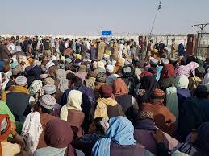
Defining the challenges
Lack of funding for refugees from donors
The Funding requirement by UNHCR is US$ 129 Million which is only 17% funded with a gap of 83%.

Slide 5
Stakeholders Analysis
Neighboring countries
Government.
Hosting communities
UNHCR
Donors
International community

Slide 6
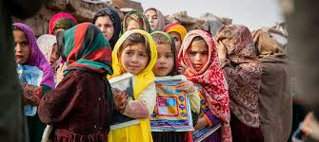
Existing Good Practices
Same language of Refugees with Hosting communities in KP and Balochistan
Social Acceptability and communal hospitality
Pakistani Government services provided to refugees without discrimination
Same culture/ Social Cohesion: Cross cultural acceptance, cross marriages
Entrepreneurial nature of Afghan Refugees
New businesses, New skills in Music, Carpet weaving, new popular Dishes

Slide 7

Existing Good Practices
Free mobility for refugees across the country
RAHA (refugees Affected Hosting area) Program, increasing the asylum space

Slide 8
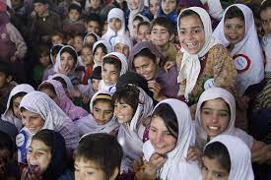
Innovative approaches
Free of cost Primary Education/ALP for out of school children
Scholarships like DAFI, for university graduates and their job placements
Livelihoods opportunities for refugees to reduce dependence on assistance

Slide 9
Way forward
Access to global markets for Pakistani industry so that the economy can provide jobs to local communities and refugees
Investment in the economies of both country of origin and country of asylum
Investment in the skills set which is relevant to local, regional and global economies
Incentivizing the hosting arrangements through improved diplomatic support and market access

Slide 10
Thanks
Share your thoughts with us

