Slide 1
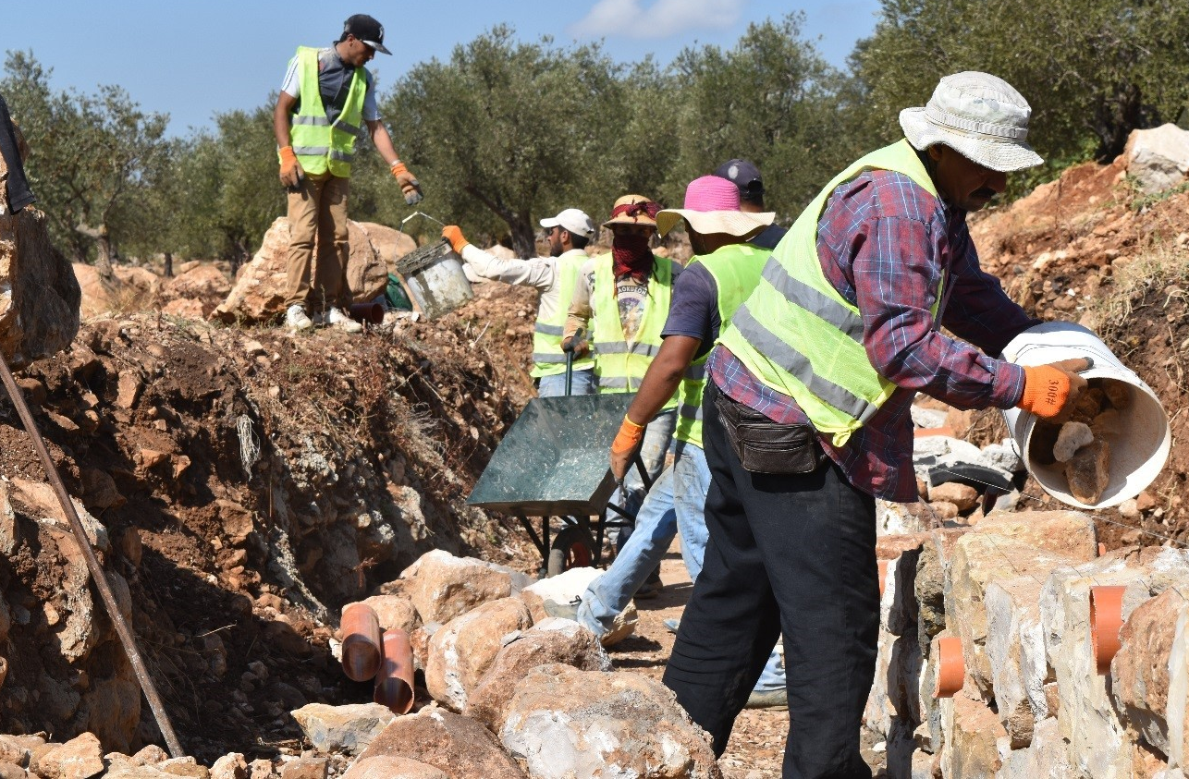

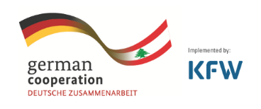
Employment Intensive Infrastructure Program in Lebanon (EIIP) - Overview
18 March 2022

Slide 2
National Challenges
Lebanon is facing a detrimental and multifaceted crisis
  Influx of Syrian refugees since 2011
  Political instability
  Covid-19 pandemic
  Beirut Port explosion 2020
  Fiscal and economic crisis
  Social tensions
Notes:
The objective of the workshop today is to understand the needs of the displaced population by highlighting some of the success factors as well as lessons learnt from interventions where refugees are targeted.
Basically, we want to understand how to create sustainable perspectives for displaced populations in a country such as Lebanon.
Lebanon has been going through major national challenges as mentioned during the presentation yesterday, namely, political instability since the start of the civil war in the 70s, influx of Syrian refugees since 2011, the covid 19 pandemic, Beirut port explosion in August 2020 and the fiscal and economic crisis through the deterioration of the LBP exchange rate to the USD, the result of which has been hyperinflation, unemployment, higher poverty rates,. All of these have caused social tensions between Syrian refugees and Lebanese host communities.

Slide 3
Challenges Affecting the Program
EIIP in Lebanon faces several challenges resulting in some adaptation of the program
  Multiple crisis in the country
  Inflation (Wages & Raw Material)
  Pre-existing tension due to political history
  Cultural Challenges
  Private sector & Decent work and LRBT
  Limited capacities of local governments to sustain interventions
Notes:
1- Multiple Crisis in the country: COVID-19, Political instability, weak infrastructure, inflation, unemployment, etc.
2- Cultural Challenges: Affecting mainly the participation of women in the construction sector, as well as the participation of persons with disabilities.
3- Private Sector have very limited capacities and knowledge relevant to decent work conditions and the application of Local resource Based Technology. As a result, a lot of resources are being mobilized to enhance training, monitoring, coaching and follow-up on site to ensure proper implementation and adaptation.
4- Local governments (municipalities in specific) have very limited resources (both financial and human resources) to sustain infrastructure assets and public goods/service,

Slide 4
Program Description
“strengthen resilience of local host communities by improving livelihoods for host community members and
Syrian refugees through job creation and infrastructure development”
Action
Asset creation
Sustainable Infrastructure and Green works
Generation of decent short-term employment
Capacity building and on the job training
Influence
Beneficiaries/workers
Decent work
Improved livelihoods and employability
Employers
Private sector capacity enhancement
Local and central government
Enhanced capacity and advocacy on EIP and decent work practices
Interest
Trigger good local development, decent work and formal labor market practices
Notes:
In response to the above challenges, the EIIP was first developed in Lebanon in 2017, The EIIP in Lebanon targets the most vulnerable from both Syrian refugees and Lebanese hosting communities (men, women and persons with disabilities), implementing its activities through local and national governments.
EIIP projects are focused on asset creation and development; such as road maintenance projects, rehabilitation of public buildings; generation of short-term jobs to Syrian refugees and Lebanese host communities and capacity building as well as skills development to beneficiaries/workers , private sector, and the local and central government.

Slide 5
Current Pillars of the program activity
Road Maintenance
6 clusters
Across Lebanon
190 Km
Beirut reconstruction
Public building & infrastructure
Agriculture
Farm infrastructure
800 farmers
Green Plan
Municipal projects + Trail
rehabilitation
Public infrastructure
7 Locations
PWD
accessibility
5 Social Development Centers
Notes:
Road maintenance (MoPWT) 6 clusters around 190km
Beirut (MoPWT & Beirut Municipality): police station started. Customs building and infrastructure in Karantina (procurement stage)
Agriculture (MoA/Green Plan): private farm infrastructure (800 farmers)
Municipal projects (Municipalities, MoSA, MoL): 8 infrastructure projects identified (component including maintenance activity along the whole of Lebanon Mountain Trail 590km)
Rehabilitation of 5 SDCs for MoSA (accessibility for People with disability)

Slide 6
EIIP Stakeholders
German Federal Ministry for Economic Cooperation and Development BMZ, through KfW
  Lebanese Government Partners
  (MoSA & MoL)
  Technical Line Ministries
  (MoA & MoPWT)
  Local Level Partners
  (Municipalities & Local Authorities
Tripartite Approach
Linkages with partners in the field
Notes:
Donor: Funded by the German Federal Ministry for Economic Cooperation and Development BMZ, through the KfW Development Bank
ILO’s Social Partners: ILO’s comparative advantage is working through a tripartite approach engaging Worker and Employer Representatives (Association of Lebanese Industrialists – ALI, General Confederation of Trade Unions for Lebanon – CGTL)
Linkages with partners in the field: LCRP, UN Agencies, I/NGOS, Livelihood Core Working Group

Slide 7
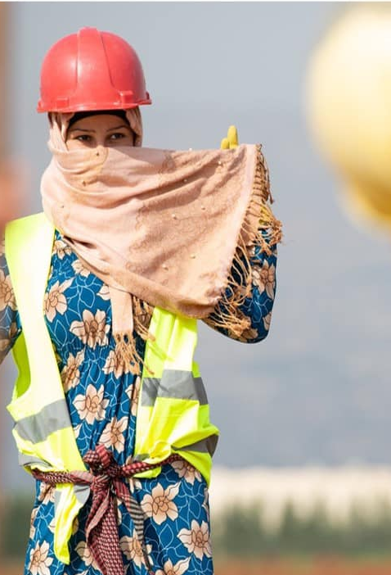

Good Practices and Innovative Approach
  Local Resource
  Based Technology
  Effective Inclusion of Persons with Disabilities
  Decent Work Principles
  Women’s Effective Participation
  Private Sector Engagement
ILO EIIP – Women participating on equal terms
ILO EIIP –Well organised and productive work.
Notes:
The core strategies of EIIP Lebanon include:
(i) Local Resource Based Technology (LRBT), i.e. work methods and technologies where the use of local resources, is favoured and optimised, without compromising the quality
(ii) Decent Work Principles, i.e. labour contracts, child labour, OJT, working hours and conditions….etc
(iii) Complemented by training for contractors and capacity building for public institutions, with gender and environmental concerns as cross cutting themes.
All put together within a social safeguard framework
The aim of EI methodology is providing short-term employment opportunities, While providing public infrastructure and services that support longer-term social, environmental and economic development.
Technically, a lot of infrastructure project that are being implemented today can switch from the traditional way of works to adopt this method that promotes employment and sustainability.
Hence, it is at the heart of the humanitarian-development-peace nexus.

Slide 8
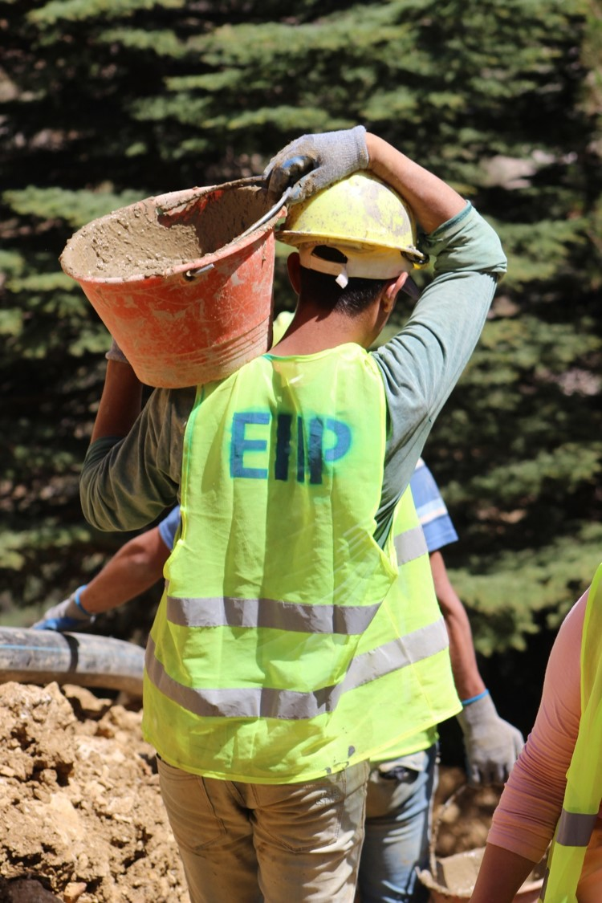
Local Resource Based Technology
  Employment optimization
  Effective planning and preparation
  Quality of work
  Skills development
  Productivity and task rates
  Private sector engagement
ILO EIIP –Well organised and productive work.
Notes:
At the centre of the EIIP is local resource based technology, which favours and optimises the use of local resources in delivering and maintaining infrastructure. Local labour and materials are used to the greatest possible extent, but without adversely affecting the costs or duration of the specified works. Appropriate (light) equipment is used for support activities for the sake of time or quality.
Labour on site is effectively organised, supervised and motivated, including fair and transparent recruitment and payment procedures. LRBT methods can if well organised be a cost-effective, viable and sustainable delivery means for infrastructure.
LRBT aims to optimize the employment content, meaning the labour content is usually lower than in the Cash-for-Work approach, but significantly higher than for conventional construction. The key differences between LRBT vs CfW are:
- Optimise employment rather than maximise to avoid non-productive labour
- Focus on Quality of construction works and importance of assets, we want to have a more sustainable impact on public infrastructure
- Quality of work (and duration), to avoid disturbing the neighbourhoods for example during road maintenance projects where there might be some reroutes during the works which might result in temporary congestion and traffic
- Productivity and task rates and output based pay become more important in EIIP
- More technical inputs are required in preparation and supervision (engineering)
- Skills development and employability objectives
- Private sector engagement through contracting the projects.

Slide 9
560,000+
  Worker-days
7,100
  Jobs
16,000+
  Leb/Syr Beneficiaries
3,625
  Women
23% Women Participation
75%
  Helpful Skills
140+
  Private Sector
75+
Municipalities
45+
  Projects
ILO EIIP – Women participating on equal terms

Slide 10
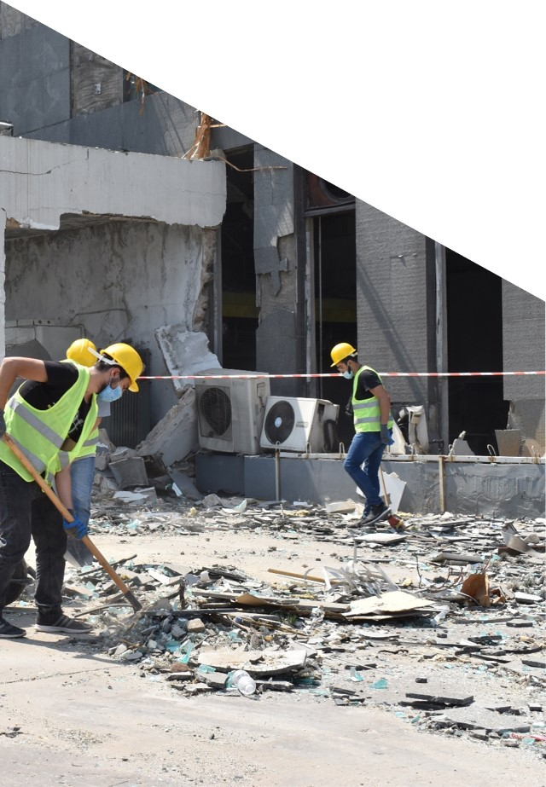
Areas of Cooperation & Improvement
Improvements
Co-Operations
Inclusive Outreach
    National Government to manage sustainability
    Local Governments
    Social Development Centres
    Local NGOs
Effective Inclusion of PWD
Breaking Cultural Barriers
Economic Reinvigoration
ILO EIIP – Debris clearing following the Beirut blast
Notes:
1- Inclusive & Comprehensive Outreach to include local governments, local NGOs/CBOs, Key actors, SDCs, Sister UN agencies working in the field.
2- Effective Inclusion of PWD: to Include inclusive engagement of work (depending on type of disability) and creating inclusive and accessible infrastructure
3- Breaking Cultural Barrier, ie changing mindset in terms of women’s participation in the construction sector and inclusion of Persons with Disabilities
4- Economic Reinvigoration utilising the LRBT approach to mobilize available local resources and re-inject money in the community.
Co-operations
1- National Government to support Local government in terms of resources to be able to manage the sustainability of the projects implemented
2- Local Governments: provide them with the needed technical expertise to manage sustainable and preserve the goods and assets produced by the EIIP. Additionally, provide them with needed technical expertise to mainstream the LRBT approach within their work and future implemented projects by other agencies.
3- Social Development Centres and Local NGOs: Provide them with needed capacity building to mainstream referrals for similar LRBT projects in the future. Ie Develop a local referral mechanism amongst each other for future interventions.

Slide 11
How is the EIIP experience Useful to Ukraine?
Outreach Approach
Outreach targets mainly Refugees, and vulnerable host communities
Job Creation
Much needed job opportunities are created for financial sustainability
Skills Development
Specifically in construction and agriculture.
Prioritization of Interventions
Projects to be prioritized based on local infrastructure needs of hosting communities
Positive Local Spill-over Effect
Through the LRBT, local development and trainings
Notes:
1- Outreach: Targets both refugees and vulnerable host communities (including women and PWD from both communities) which would reduce social tensions, specifically in vulnerable areas where usually refugees are present.
2- Job Creation: Ensures financial sustainability and also enhances social security (crimes, thefts, etc.) resulting from low access to money
3- Skills Development through On the Job Training in construction and agriculture, allowing refugees to develop useful skills for post conflict activities
4- Prioritization of Interventions based on local needs of host communities leads to local infrastructure development in areas that are much needed through EIIP projects, while reducing the pressure off local governments.
5- EIIP through its Local Resource Based Technology and Labour Intensive approach is known to have a positive spill-over effect in local communities, where it encourages the use of local resources (from labour to raw material and services) leading to enhanced local economy, it optimizes the use of labour reducing the use of machinery that may have major destructive effects on the environment. EIIP invests a lot in trainings, providing workers and partners with sustainable skills that can be used in different contexts beyond the EIIP.

Slide 12
Thank You
For more information, please visit: www.EIIPLebanon.com

