Slide 1
National EMN Conference + Workshop 2022
Success Factors to Create Sustainable Perspectives for Displaced Population
Focus on: Livelihoods Sector in Turkey
18 March 2022
Ibrahim Halil Timurtas
Head of Sub-Office, IOM Hatay, Turkey

Slide 2
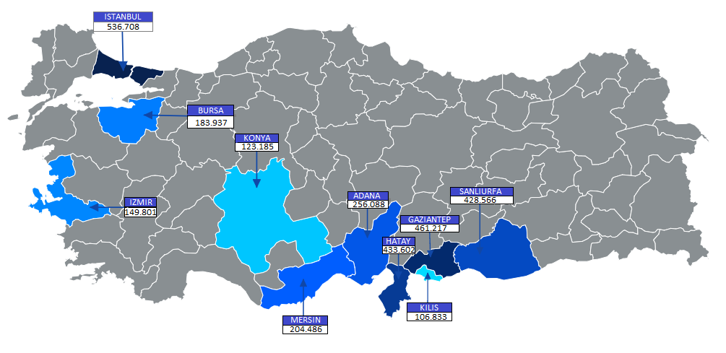
Turkey Facts &Figures
Registered Syrian Refugees | Total Refugees in Need | Host Community in Need
3.744.139 | 4.131.541 | 8.500.000
Distribution of SuTPs by Top 10 Provinces in Turkey

Slide 3
LIVELIHOOD, FACTS&FIGURES for TURKEY
Current Situations
  Since the adoption of the Regulation on Work Permits for Foreigners under Temporary Protection in 2016, the number of work permits granted to Syrians was 132,497 as of the end of 2019, including the work permits granted to Syrians with residence permits.
  Activities continue to increase the employability for foreigners, including Syrians under temporary protection. These activities are carried out in the context of integration in the labor market and on the basis of skills assessments. As of January 2021, a total of 4,198 foreigners obtained Vocational Qualifications Authority (VQA) certificates.
  The Livelihoods sector has supported SuTPs and the host community through the provision of Technical and Vocational Training and Education (TVET), skills and language training to increase access to employment opportunities, and facilitation of formal job creation,
  In parallel, both Turkish and Syrian owned businesses have experienced the negative effects of the COVID-19 pandemic.

Slide 4
LIVELIHOOD, FACTS&FIGURES for TURKEY
Needs, Vulnerability and Target,
  More than 2 million of the 3.7 million SuTPs and the 320,000 IP applicants and status holders are of working age.
  Approximately 800,000 Syrians have been working informally and 45% of SuTPs and other IP applicants and status holders are living below the poverty line, including 39% considered to be multi-dimensionally poor.
  Syrian workers earn on average below the minimum wage, whereas Syrian women earn even less than their male counterparts and 75% work more than 45 hours per week.
  The overall approach of livelihoods partners will continue to target individuals of working age, including female-headed households and people with disabilities from multi-dimensionally poor households.

Slide 5
LIVELIHOOD, FACTS&FIGURES for TURKEY
Needs, Vulnerability and Target
  As the increasing competition over the labour market may result in social tensions, the Livelihoods sector will also target an equivalent number of impacted members of the host community.
  The Livelihoods sector will also be targeting over 20,000 students amongst SuTP, IP applicants and status holders enrolled in Turkish universities to increase the access of qualified workforce into the Turkish labour market.
  The socio-economic impacts of COVID-19 have also adversely affected small and micro companies.
  As 59% of Syrian companies are facing the risk of closure due to COVID-19, micro and small enterprises will be targeted with a combination of technical and financial support while also building partnerships and coordination mechanisms with larger enterprises.

Slide 6
Unemployment rate in Turkey: 11.4 %, as of March 2022
Inflation rate: 54.4 %, as of March 2022
Population Table for Working Age of SuTPs
Age | Male | Female | Total
19-24 | 273.466 | 206.614 | 480.08
25-29 | 233.553 | 166.802 | 400.355
30-34 | 167.345 | 123.033 | 290.378
35-39 | 130.441 | 100.344 | 230.785
40-44 | 88.479 | 74.803 | 163.282
45-49 | 61.217 | 59.627 | 120.844
50-54 | 46.249 | 45.231 | 91.480
55-59 | 36.464 | 36.671 | 73.135
60-64 | 23.631 | 24.595 | 48.226
Grand Total | 1.060.845 | 837.72 | 1.898.565

Slide 7
LIVELIHOOD, FACTS&FIGURES for TURKEY
Strategic Directions and Response
  The Livelihoods sector will continue to support its partners to promote harmonization, social cohesion and durable solutions.
  The Livelihood partners aim to assist the transition of vulnerable groups towards self-reliance through a comprehensive approach that supports the supply and demand sides of the labour market while contribute in establishing an enabling environment to facilitate access of vulnerable groups to decent and formal work.
  The Livelihoods partners will work in complementarity and coordination with the Government, line ministries, International Financial Institutions (IFIs), donors and other relevant institutions to support them to respond to the socio-economic impacts of COVID-19.
  The mapping of overall on-going initiatives and available funds will also continue to guide the sector.
  The Livelihoods sector aims to assist the transition of vulnerable groups towards self-reliance through improved referral and follow-up systems with other sectors and service providers with a specific consideration for women headed households.

Slide 8
LIVELIHOOD, FACTS&FIGURES for TURKEY
Strategic Directions and Response
  The Livelihoods sector aims to support the private sector by providing targeted, flexible and occupation-specific online and blended learning opportunities (covering language and vocational skills) for a better job/skills matching and job placements.
  The sector partners aim to provide financial and technical support for the creation of new small businesses and provide support to existing businesses on digitalization, labour law and e-commerce.
  The qualified workforce gap in the IT sector in Turkey is over 30% and providing coding and other digital skills training to vulnerable groups and host community youth in Turkey will be beneficial to facilitate access to the digital economy as well as more sustainable jobs and (digital) livelihood opportunities.
  Focusing on the green economy and waste/water management sectors can also help foster new partnership opportunities with the private sector, local public institutions and municipalities and create new employment opportunities and sustainable green jobs.

Slide 9
LIVELIHOOD, FACTS&FIGURES for TURKEY
Accountability Framework
  The Livelihoods sector will continue to coordinate closely with key institutions.
  These include:
    The Ministry of Family, Labour and Social Services (MoFLSS), Directorate General of Migration Management (DGMM),
    Ministry of Industry and Technology(MoIT), Ministry of National Education (MoNE),
    Ministry of Agriculture and Forestry (MoAF), as well as the Turkish Employment Agency (ISKUR),
    Social Security Institution (SSI), Chambers of Commerce,
  This ensures that the sector strategy is aligned with the priorities of public institutions, private sector and NGOs. New partners from Government and business networks will be approached and invited to the sector.
  The engagement of the private sector in the planning and coordination will be a priority.
  Monthly Livelihoods Working Group Meetings will also continue to serve as an information sharing platform to discuss updates as well as strategies, and referrals to other sectors and institutions.

Slide 10
CHALLENGES
Access to employment as well as creation and retention of businesses continue to be challenged by various factors:
  Language barriers,
  Lack of job-related skills,
  Lack of awareness on the labour market modalities,
  Lack of e-commerce skills,
  Lack of information on the legal frameworks regarding employment and entrepreneurship,
  Lack of access to funding,
  Lack of enough capital
  The negative socio-economic impacts of COVID-19, further increased challenges to access livelihoods opportunities and endangering income security for SuTPs,
  Lack of access of qualified workforce into the Turkish labour market.

Slide 11
Livelihoods Achievements
As of December 2021:
  66,356 direct beneficiaries, of whom 54% were female, have been reached through Livelihoods sector partners.
  31,380 individuals (SUTPs) and IPs and from the host community completed vocational, language and soft skills trainings.
  9,530 individuals increased their income with job placement or other income opportunities,
  10,797, individuals were supported with work permit provision, counselling or business establishment or expansion.
  3,061 small and medium-sized enterprises and start-ups benefitted from business management, financial and technical support in their establishment or expansion process.
  1,003 individuals have been supported to establish new or expand businesses.
  6,422 SuTPs were supported with Vocational Qualifications Certificates.
  Livelihood Sector Financial Requirements by Agency for 2022: 116,000,000 USD
Livelihoods Achievements | Achieved | Target | %
Refugees or host community members completed trainings | 31,380 | 67,882 | 46%
Individuals increased income through job placement and income opportunities | 9,530 | 20,365 | 47%
SMEs, businesses supported through business management trainings, financial/non-financial services or technology transfer | 3,061 | 16,031 | 19%

Slide 12
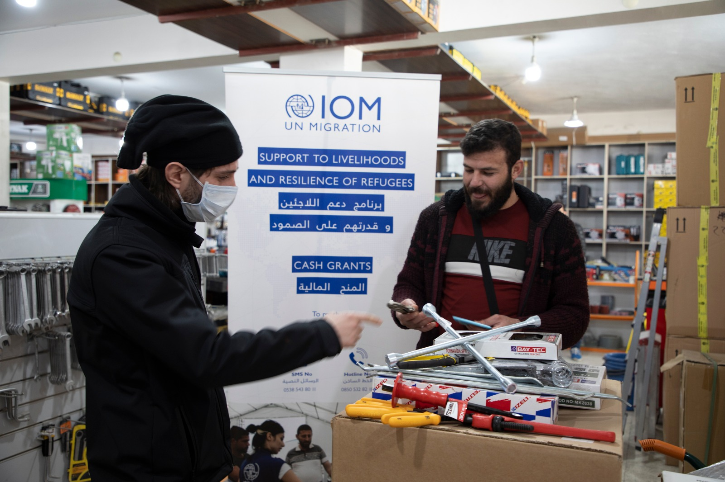
Livelihood Projects by IOM (2016-2022)
Cash Grants for MSEs
In order to support vulnerable families to become more self-reliant, IOM provided small grants for small business start-ups in line with the needs and skills of individuals to encourage income-generating activities.
In 2022 the project is being implemented in Adana, Hatay, Gaziantep, Kahramanmaras, Mardin, and Sanliurfa targeting 240 beneficiaries in total.
Year | Male | Female | Total
2017 | 269 | 33 | 302
2018 | 661 | 93 | 754
2019 | 278 | 138 | 416
2020 | 44 | 21 | 65
2021 | 162 | 56 | 218
Grand Total | 1414 | 341 | 1755

Slide 13
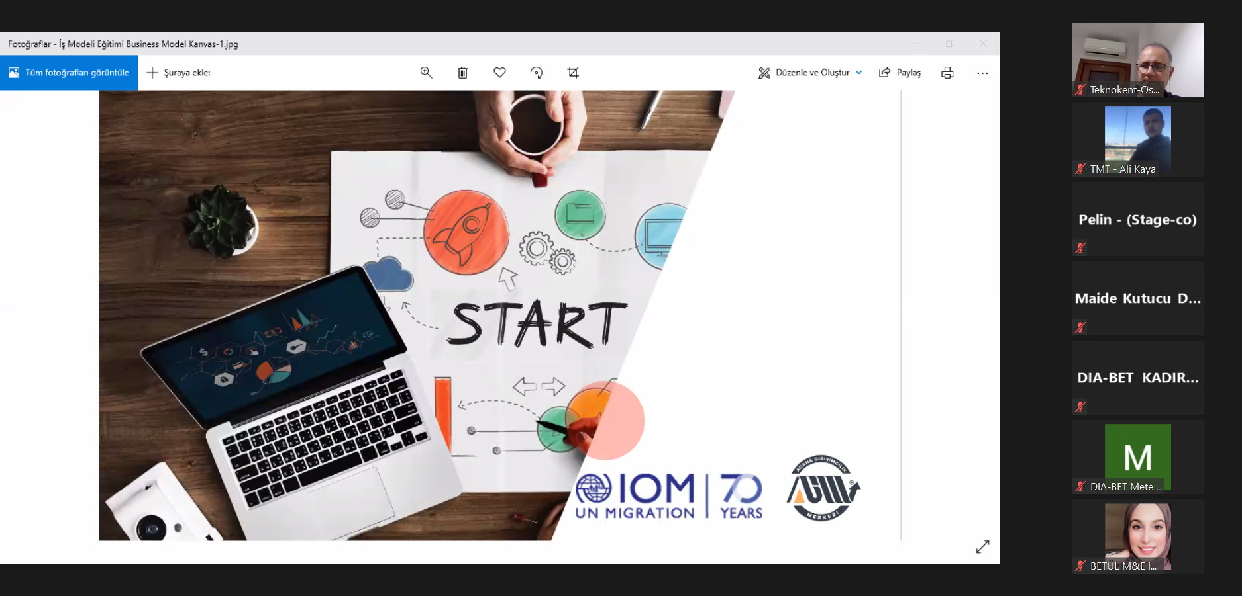
Entrepreneurship Training and Grant Program
Partnership with Universities, local NGO,
IOM targeted a total of 300 participants from each University for a Start-up training (undergraduate, and graduate youth from both refugee and host communities)
The training provided soft skills and 3D prototyping technologies.
Two teams from each location with the strongest business plan were provided with grants equivalent to 100.000 TRY as seed fund,
Project Location: Gaziantep, Hatay, Sanliurfa, Izmir, and Adana
Since 2017 IOM supported 836 beneficiaries in total,

Slide 14
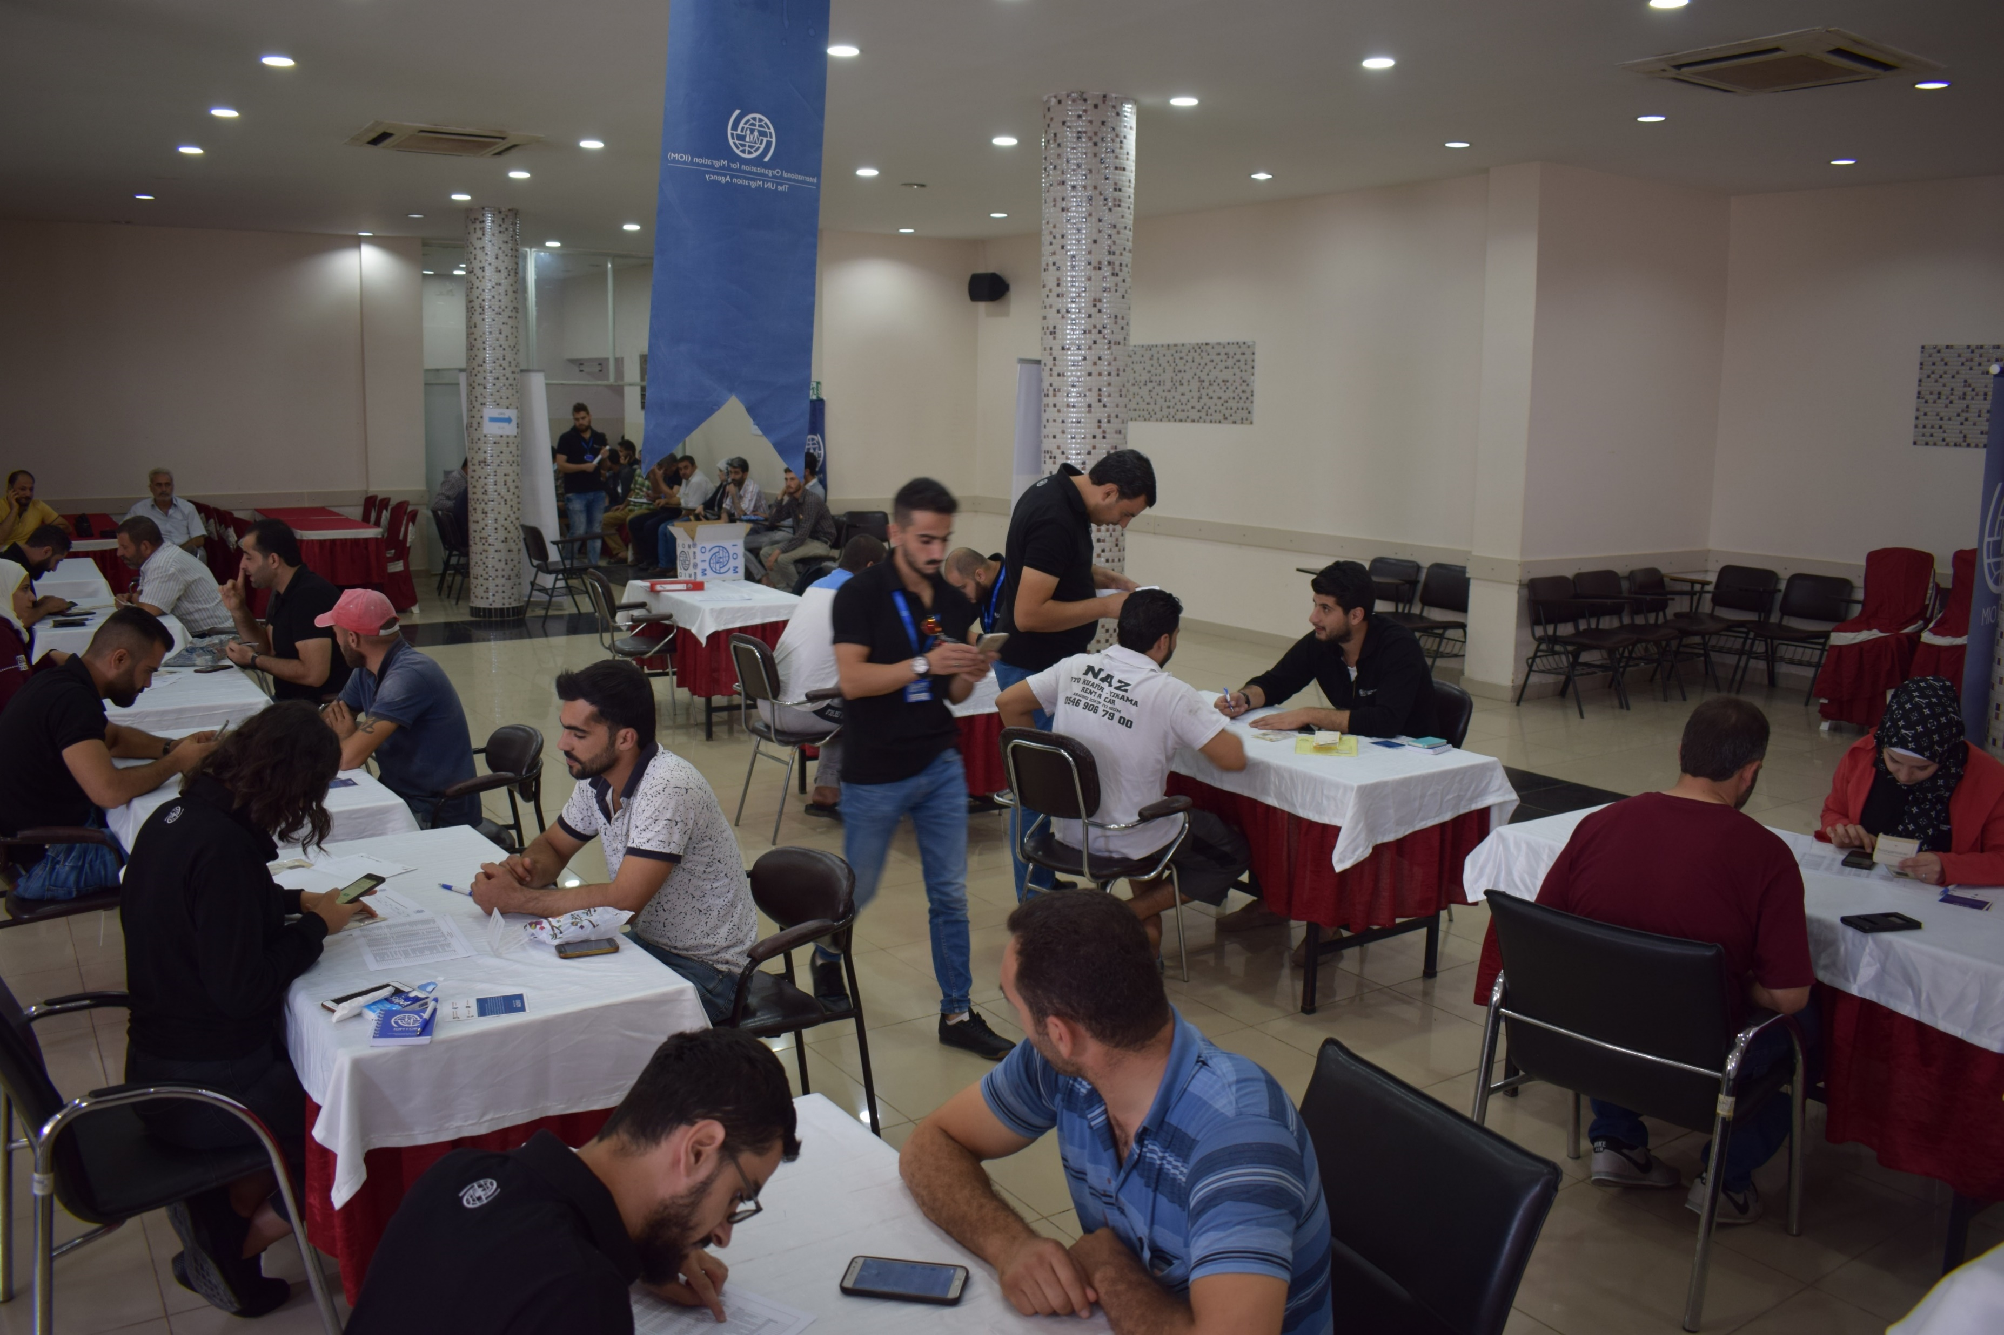
Job Placement Program
IOM provided income-generating opportunities through direct and registered employment with Turkish Businesses.
IOM covered the work permit fee, salary, and insurance for 3 months with a commitment that the company would cover the remaining 9 months.
Since 2016 IOM has supported 321 beneficiaries in total.

Slide 15
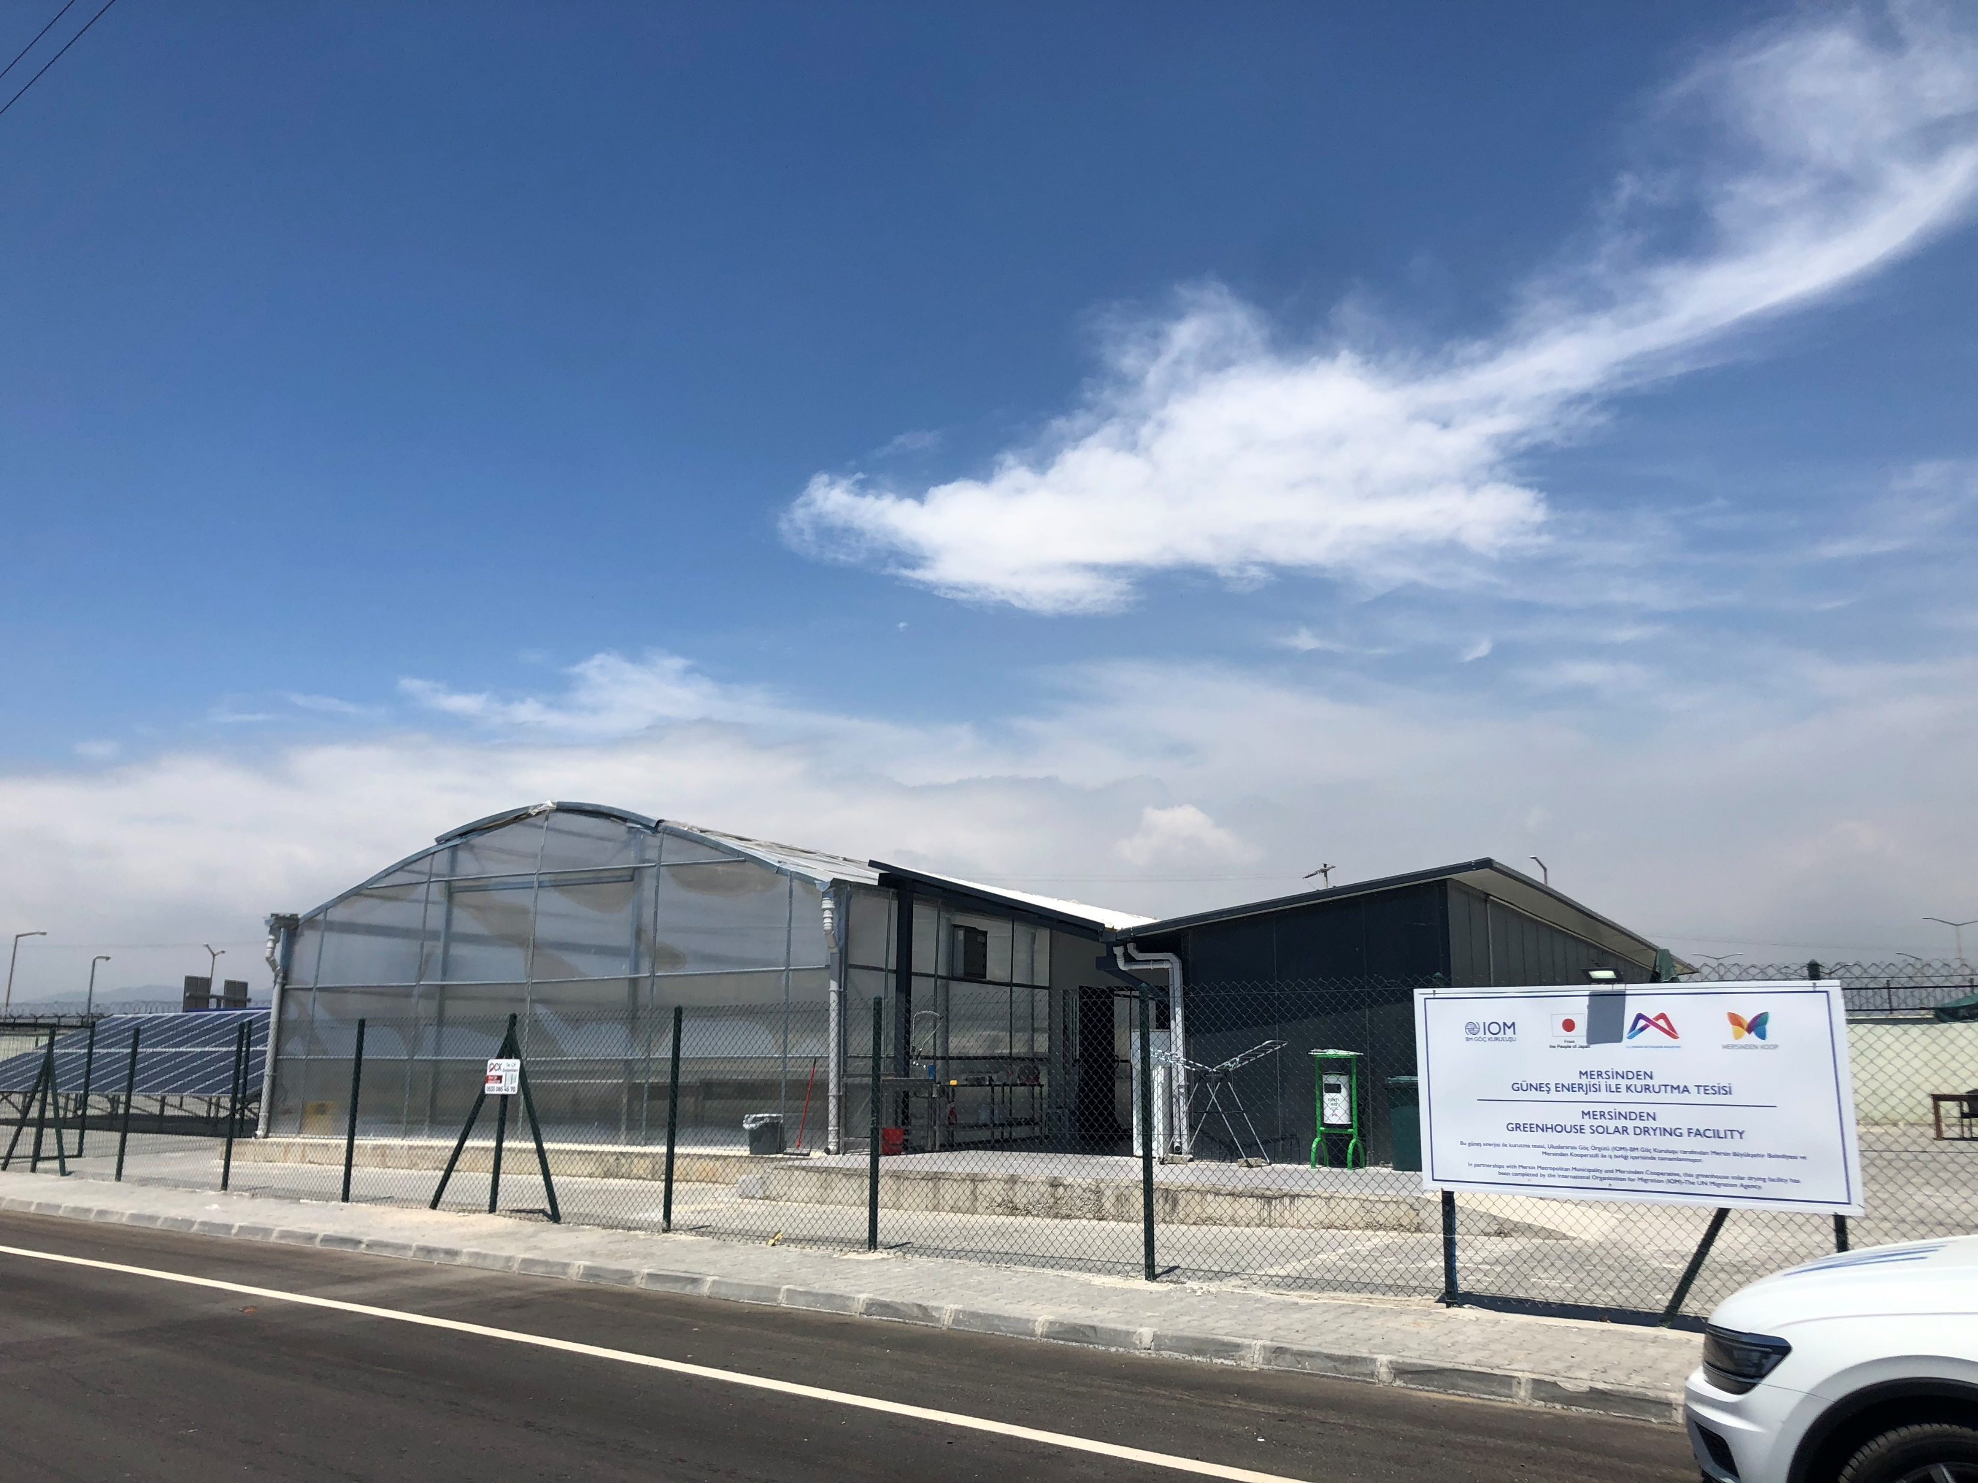
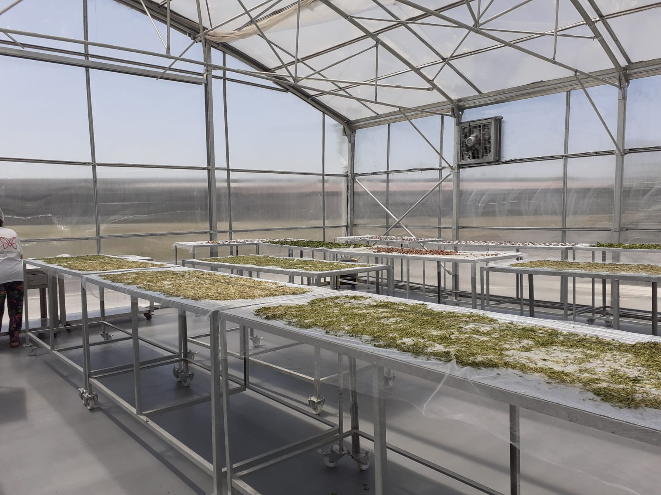
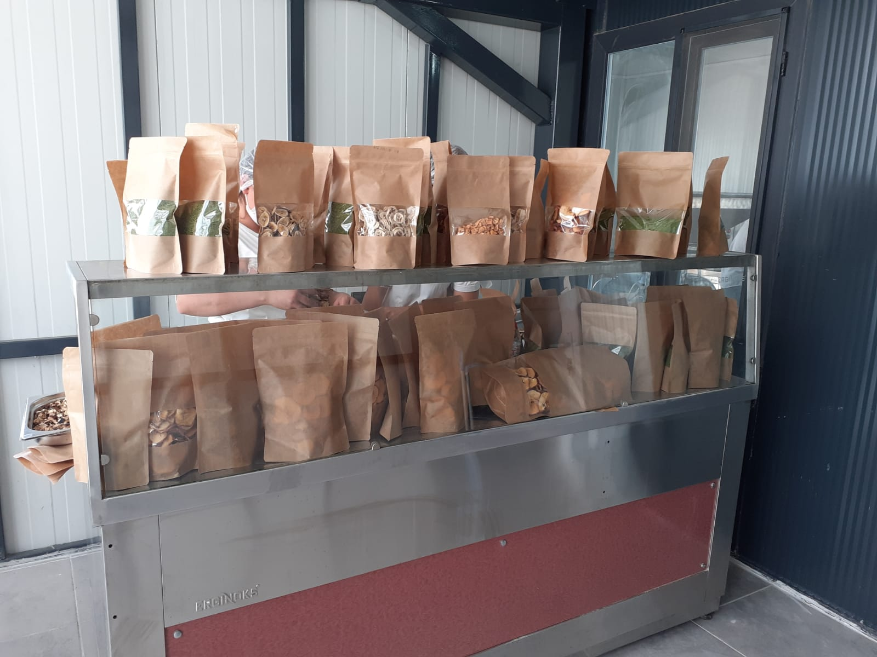
Community Farming
Construction of 10 solar dryer greenhouses in Mersin, Adana, Hatay, Gaziantep, Kahramanmaras, Mardin, Kilis and Sanliurfa ,
Engagement with local authorities and women cooperatives
IOM established ten solar dryer greenhouses under this project, reaching 300 female beneficiaries from both host and refugee community (%50:%50) individuals directly
Total budget: 98,125 USD per Solar drier greenhouse

Slide 16

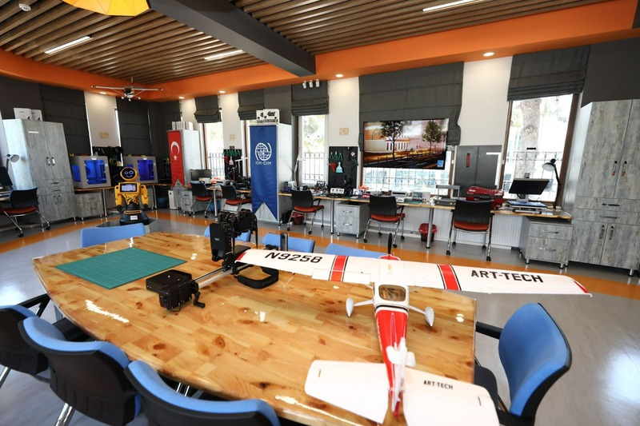
The Resilience Innovation Facility (FabLab, Gaziantep University)
Opened on the 02 August 2021, Fab-lab Gaziantep operates an open-door policy with targeting refugee, migrant and Turkish host community youth living in Gaziantep.
Non-university students who have not had a higher education but who wish to learn vocational skills and/or useful digital skills that can support their decision-making and management of their lives,
Provides training on digital financial management, business development training, computer literacy, accessing education opportunities and seeking information about support services.

Slide 17
Breakout Session Questions
What specific actions are needed to tackle these challenges? What specific examples?
What other critical challenges are there? What specific examples?
How to get higher involvement from private sector?
How to get SUTPs involved in IT sector? As the qualified workforce gap in the IT sector in Turkey is over 30%.
How to improve livelihood opportunities both for refugee and host communities?
How to get more SUTPs involved in Agribusiness sector?
Who to engage to make sure livelihood activities are done right and will be sustainable?

Slide 18
ANY QUESTIONS / COMMENTS?

