Slide 1
The Humanitarian-Development-Peace Nexus
National EMN Conference
17 March 2022
Annika Sandlund – Head of Partnership and Coordination Service,
Division of External Relatons, UNHCR

Slide 2
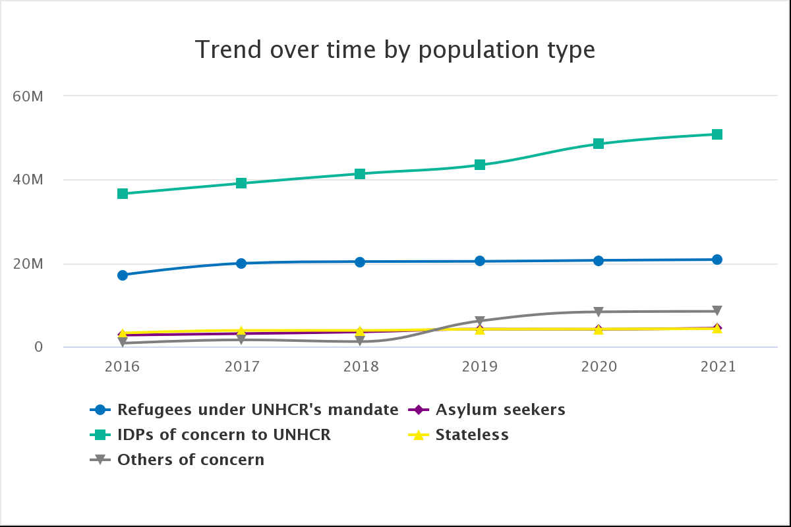
Forced Displacement and the HDP Nexus
Approx. 83 million people were forcibly displaced, before the Ukraine situation
85 % of the 26.6 million refugees are hosted in developing countries
Almost 16 million refugees live in protracted situation
Life-saving humanitarian aid is an insufficient response to protracted situations
The Humanitarian-Development-Peace (HDP) nexus aims at providing a comprehensive response to protracted crises in line with 2030 Agenda
Notes:
Numbers of forcibly displaced, which include refugees, asylum seekers and IDPs, are rapidly increasing. As of this morning, the UNHCR data portal reported xxxxx refugees from Ukraine in neighbouring countries.
Protracted refugee situation is characterized by at least 25,000 refugees hosted for five years in the same host country.
In 2020, 49 refugee situations were classified as protracted.
This presentation aims at providing a short overview of key frameworks and policy documents that are relevant for the implementation of the nexus, as well as providing a few practical examples.

Slide 3
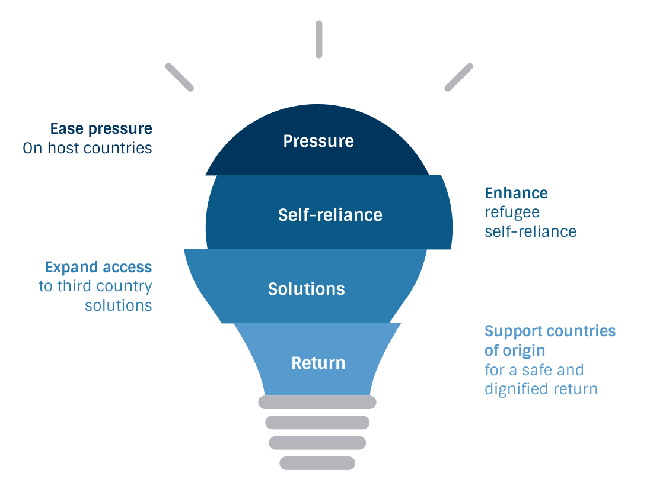
Global Compact on Refugees (GCR)
A global agreement on comprehensive refugee responses
Achieved through:
4 interlinked and interconnected objectives
Mobilization of political will
Broadened base of support
Whole-of-government & whole-of-society engagement
Multi-stakeholder and partnership approach
Ease
Notes:
On 17 December 2018, the United Nations General Assembly affirmed the Global Compact on Refugees (GCR). The GCR provides a blueprint for governments, international organizations, and other stakeholders to ensure that host communities get the support they need and that refugees can lead productive lives.
It constitutes a unique opportunity to transform the way the world responds to refugee situations, benefiting both refugees and the communities that host them.
Four key objectives of the GCR:
Ease the pressures on host countries;
Enhance refugee self-reliance;
Expand access to third-country solutions;
Support conditions in countries of origin for return in safety and dignity.
There are many inspiring stories, such as scholarship programs for refugees in Canada or the inclusion of refugees in businesses, such as UNIQLO.

Slide 4
Global Compact on Refugees (GCR)
Support Platforms
Support platforms were activated to support the implementation of the GCR and reinforce regional refugee responses
Comprehensive Regional Protection and Solutions Framework (MIRPS) to support responsibility sharing in Central America and Mexico
Solutions Strategy for Afghan Refugees (SSAR) to ensure a regional approach to create an environment conducive to voluntary repatriation and sustainable reintegration inside Afghanistan, while easing pressure on host communities.
Intergovernmental Authority on Development (IGAD) to channel efforts and amplify impact on return and integration, education, economic inclusion of refugees and Health in Eastern Africa and
Notes:
The functions of a Support Platform include:
galvanizing political commitment and advocacy for prevention, protection, response, and solutions;
mobilizing financial, material, and technical assistance, as well as resettlement and complementary pathways for admission to third countries;
facilitating coherent humanitarian and development responses, including through the early and sustained engagement of development actors; and
supporting comprehensive policy initiatives to ease pressure on host countries, build resilience and& self-reliance, and find solutions.
IGAD region is in the east of Africa and covers: Sudan, South Sudan, Ethiopia, Djibouti, Somalia, Uganda and Kenya.

Slide 5
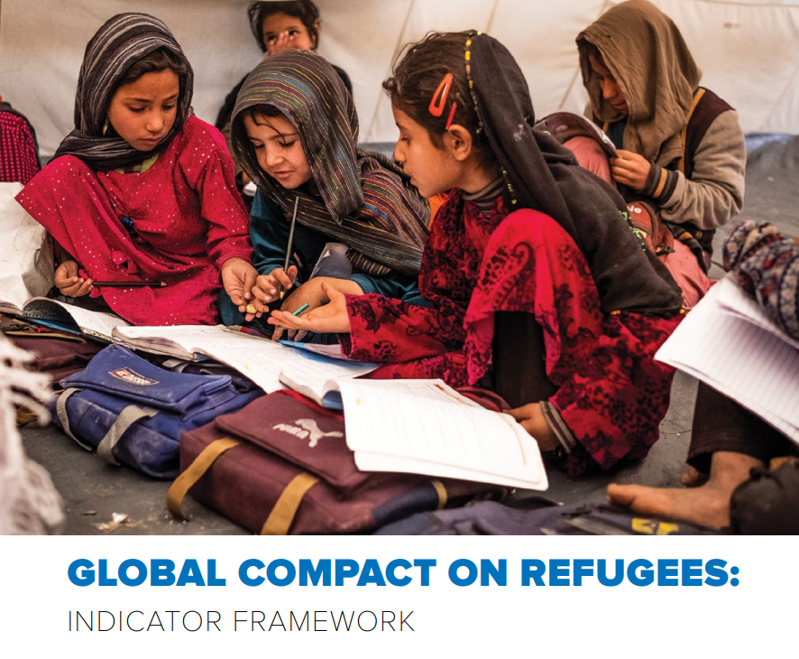
Global Compact on Refugees (GCR)
Pledges – samples –
As part of its GRF pledge on HDP nexus, UNDP is working to ensure that 100% of its relevant recovery, resilience and development programmes in over 40 refugee hosting /potential return countries/countries of origin to address the root causes and include refugees and host communities, also in line with Leave No One Behind (LNOB) pledge of the 2030 Agenda.
From 2019 to 2023, the Netherlands has committed 500 million euro to the PROSPECTS partnership initiative where the World bank, IFC, ILO, UNICEF and UNHCR take a joint, integrated approach using their complementary strengths to improve prospects for refugees and host communities in 8 countries (Iraq, Jordan, Lebanon, Egypt, Sudan, Ethiopia, Kenya and Uganda). The partnership is pushing for a paradigm shift from a humanitarian to a development approach towards forced displacement.
Notes:
The functions of a Support Platform include:
galvanizing political commitment and advocacy for prevention, protection, response, and solutions;
mobilizing financial, material, and technical assistance, as well as resettlement and complementary pathways for admission to third countries;
facilitating coherent humanitarian and development responses, including through the early and sustained engagement of development actors; and
supporting comprehensive policy initiatives to ease pressure on host countries, build resilience and& self-reliance, and find solutions.
IGAD region is in the east of Africa and covers: Sudan, South Sudan, Ethiopia, Djibouti, Somalia, Uganda and Kenya.

Slide 6
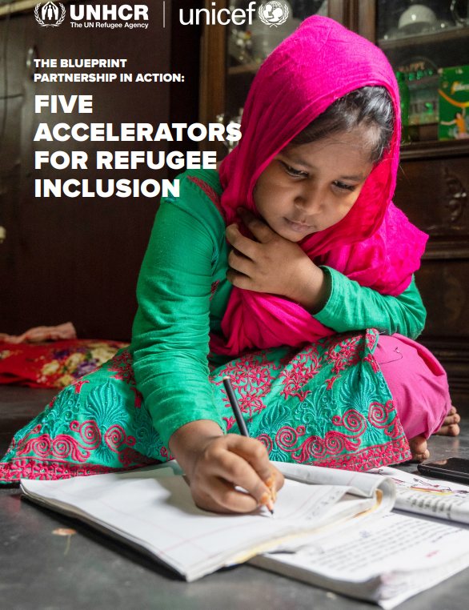
UNICEF-UNHCR Blueprint
In 2020, following the Global Refugee Forum, UNHCR and UNICEF launched the Blueprint for Joint Action.
Primary goal: inclusion of refugee children and their families in nationally led systems and services,
Has focused on the priority areas of education, WASH, child protection, and data, in 10 countries that host over 2 million refugee children.
By focusing on inclusion in national systems, services and budgets, the Blueprint is at the centre of the humanitarian/development nexus.
Notes:
In 2020, following the Global Refugee Forum, UNHCR and UNICEF launched the Blueprint for Joint Action to act upon the main guiding principles of the Global Compact for Refugees - predictable and equitable responsibility-sharing, creating sustainable and durable solutions to refugee situations and addressing the needs of host communities. By working together and leveraging the comparative strengths of both UNICEF and UNHCR, the Blueprint is UN reform in action.
The Blueprint has been run as a pilot program for the past two years to learn how the two organizations work best together and to collect good practices as well as identify the biggest challenges. It has the primary goal of the inclusion of refugee children and their families in nationally led systems and services, and has focused on the priority areas of education, WASH, child protection, and data, in 10 countries that host over 2 million refugee children.
By focusing on inclusion in national systems, services and budgets, the Blueprint is at the centre of the humanitarian/development nexus. As we come to the end of the pilot program, collected learnings are informing a new strategic global partnership framework that will bring forward the same balance of humanitarian and development work that is crucial to building sustainable and effective programming. The new framework is currently being developed.

Slide 7
DAC Recommendation on the HDP Nexus
In 2019, the OECD’s Development Assistance Committee (DAC) adopted the DAC Recommendation on the Humanitarian-Development-Peace Nexus and UNHCR adhered in 2021
The Recommendation outlines principles for coordination, programming and financing to deliver the nexus approach in developing countries.
The DAC Recommendation on the Nexus also explicitly applies in refugee situations.
UNHCR contributed to development of the International Network on Conflict and Fragility (INCAF) Common Position outlining good practice principles for a nexus approach for refugee situations in low and lower middle-income hosting countries and fragile contexts.
Notes:
The DAC Recommendation aims to provide Adherents with a comprehensive framework that can incentivize and implement more collaborative and complementary humanitarian, development and peace actions, particularly in fragile and conflict-affected situations.
It provides a common set of eleven principles to guide and support Adherents, in their capacity as donors, development cooperation actors and stakeholders in the international community.
The DAC Recommendation also aims to strengthen coordination, programming and financing to address risks and vulnerabilities, strengthen prevention efforts and reduce need in order to ensure that we reach the furthest behind.
UNHCR contributed to the development of the common position on supporting comprehensive responses in refugee situations,26 issued by the DAC’s International Network on Conflict and Fragility (INCAF). UNHCR supported the OECD in developing indicators for improved data collection on projects and programmes benefiting refugees and also provided protection expertise in developing the eligibility criteria for development interventions on (forced) migration.

Slide 8
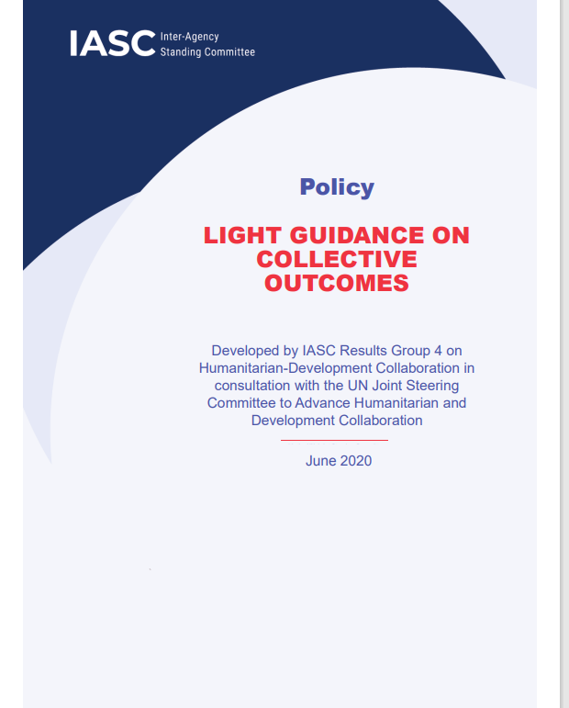
IASC Light Guidance on Collective Outcomes
Strategic tool for humanitarians, development and peace actors to agree on a concrete and measurable results
Aims is to jointly reduce people’s needs, risks and vulnerability.
A shared analysis allows HDP actors to align their programming, based on the comparative advantage of each actor
Notes:
Collective outcomes set a concrete and measurable result that humanitarian, development and peace actors want to achieve jointly in a country to reduce people’s needs, risks and vulnerabilities.
As such, collective outcomes are the main tool for closer humanitarian-development and peace collaboration. They envision a common result, promote the connectivity and complementarity between plans and programmes within existing mandates and in respect of principles.
Collective outcomes can also allow and promote more efficient funding and financing solutions by highlighting programmes that jointly executed contribute to the achievement of collective outcomes.
8-step Framework for operationalizing collective outcomes:
Step 1: Identify triggers and understanding readiness
Step 2: Convening stakeholders and getting organized
Step 3: Undertaking joint analysis
Step 4: Formulating and programming for collective outcomes
Step 5: Financing programmes contributing to collective outcomes
Step 6: Implementing collective outcomes
Step 7: Monitoring progress and evaluation results
Step 8: Mainstreaming collective outcomes

Slide 9
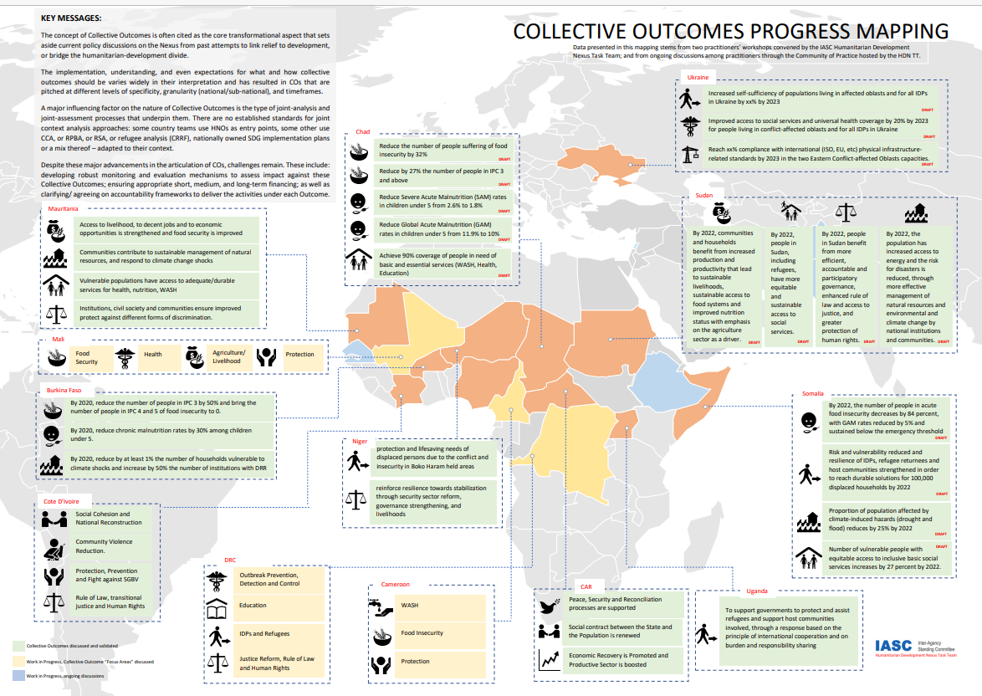
Collective Outcomes – Progress and challenges
Despite these major advancements in the articulation of COs, challenges remain.
These include
  developing robust monitoring and evaluation mechanisms to assess impact against these COs;
  ensuring appropriate short, medium, and long-term financing;
  clarifying/ agreeing on accountability frameworks to deliver the activities under each Outcome.
Source: IASC

Slide 10

Promising examples
Partnership with the World Bank Group
Non-transactional partnership between UNHCR and the World Bank Group (WB) to enhance focus on the medium-term, socio-economic dimensions of the crisis for the forcibly displaced and their host communities.
UNHCR advises development actors on protection issues including assessment of countries’ refugee protection framework for the funding under the International Development Association’s (IDA) sub-window for refugees
Joint Data Center on Forced Displacement to improve data collection and analysis to enhance evidence-informed humanitarian and development actions
Notes:
Non-transactional partnership means that UNHCR does not receive any funding from the World Bank.
The World Bank announced a $93 billion replenishment package of the International Development Association (IDA) to help low-income countries respond to the COVID-19 crisis and build a greener, more resilient, and inclusive future
The funds will be delivered to the world’s 74 poorest countries between July 2022 and June 2025 under the 20th replenishment (IDA20) program, which focuses on helping countries recover from the impacts of the COVID-19 crisis.
The IDA20 program has ambitious policy commitments that will support countries in prioritizing investments in human capital, covering issues such as education, health and nutrition, vaccines, safety nets, and support for people with disabilities. IDA will also increase its ambition in addressing other major development challenges such as gender inequality, job creation, and situations of fragility, conflict and violence, including in the Sahel, the Lake Chad region, and the Horn of Africa.
A continued emphasis on governance and institutions, debt sustainability, and digital infrastructure interventions will help foster economic and social inclusion.

Slide 11
Promising examples
Innovative Financing
Innovative financing help UNHCR close the funding gap through a range of mechanisms aimed at generating financing for humanitarian aims from capital markets
Kiva’s World Refugee Fund. Kiva is an international non-profit working to
  expand financial access to underserved communities through a Fund, which works by crowdfunding loans
Social Impact Bonds Colombia: Empleando Futuro
Humanitarian Impact Bond (HIIB): Development impact bonds (DIBs) 26 million CHF capital to build and run three new physical rehabilitation centers in Nigeria, Mali, and the Democratic Republic of Congo over a five-year period
Notes:
At UNHCR, the term innovative finance refers to financial arrangements to support UNHCR’s mission that are not traditional donor-funded grants. These innovative financing mechanisms can include investments, impact bonds, swaps, guarantees, blended finance, and other vehicles, depending on the specific priority being supported. Innovative financing can also help humanitarian organizations diversify their funding base and, in line with the Global Compact on Refugees, bring in a wider range of stakeholders and their financial and other capabilities to supporting displaced people and host communities.
Kiva’s World Refugee Fund. Kiva is an international non-profit working to expand financial access to underserved communities. In 2017, they launched the Fund, which works by crowdfunding loans and unlocking capital by mobilizing lenders to support refugees and IDPs, and hosting communities.
The Fund offers 0% interest and risk-tolerant funding to local institutions (Kiva’s field partners4) who in turn provide loans to refugees and IDPs at scale. They tailor loans to refugees and IDPs’ needs by offering smaller loan sizes, expanding the type of identification accepted and being more lenient on guarantor and collateral requirements. They work with UNHCR and NGOs that provide services for refugees and IDPs.
A social impact bond (SIB) is a contract with the public sector or governing authority, whereby it pays for better social outcomes in certain areas and passes on part of the savings achieved to investors. A social impact bond is not a bond, per se, since repayment and return on investment (ROI) are contingent upon the achievement of desired social outcomes. If the objectives are not achieved, investors receive neither a return nor repayment of principal. SIBs derive their name from the fact that their investors are typically those who are interested in not just the financial return on their investment, but also in its social impact.
While the unemployment rate in Colombia very high among vulnerable populations, such as IDPs, indigenous populationAfro-Colombians and women, who are more likely to work in Colombia’s large informal sector. The armed conflict in Colombia has exacerbated these labor market inequalities, with Colombia having the world’s largest internally displaced population. An estimated one out of two people in extreme poverty is an internally displaced person.
The SIB will support a range of employment measures, including skills training, psychosocial support, and intermediation services for job placement and retention for vulnerable individuals. In particular, the intervention will be targeted at high school graduates between 18 and 40 years old, who are not formally employed at the start of the program, who are registered in Red Unidos (the extreme poor), or who are victims of displacement due to the armed conflict.
The investors in the SIB are a coalition of foundations including Fundación Corona, Fundación Bolivar Davivienda, and Fundación Mario Santo Domingo, who are providing upfront capital to finance the intervention. The government of Switzerland will fund the remaining portion through its State Secretariat for Economic Affairs (SECO). The Inter-American Development Bank’s (IDB) Multilateral Investment Fund (MIF) is channeling the outcome funds of SECO, as well as supporting various aspects of the design work. Instiglio, a global non-profit impact bond and results-based financing advisory organization, advised the design of the SIB.
Humanitarian Impact Bond (HIIB) developed by the International Committee of the Red Cross (ICRC) modeled after development
impact bonds. This innovative financing mechanism raised 26 million CHF capital to build and run three new physical rehabilitation centers in Nigeria, Mali,
and the Democratic Republic of Congo over a five-year period. These centers primarily serve people wounded in conflict. The mechanism has encouraged
social investments from the private sector to support ICRC’s health programs. The program’s impact has yet to be evaluated as its end date is not until July
2022. Development impact bonds (DIBs) work by getting an investor to pay up front for the costs of an intervention that is then measured by clear, predetermined metrics. If the intervention succeeds in achieving the goals, the outcome payor — typically a donor agency, foundation or perhaps a company — will pay the investor back based on the performance.
The international community needs to invest in countries implementing inclusive and innovative financing policies, such as social impact bonds, bank guarantees, and entrepreneurial mechanisms. It is key to leverage private sector engagement and resources to scale up humanitarian interventions and accelerate inclusion and development processes of refugee populations. There is finally a need to invest in green energy in refugee-hosting contexts
to promote access to electricity and digitalization, which are crucial to enabling refugees to access information, rights, and learning opportunities.

Slide 12
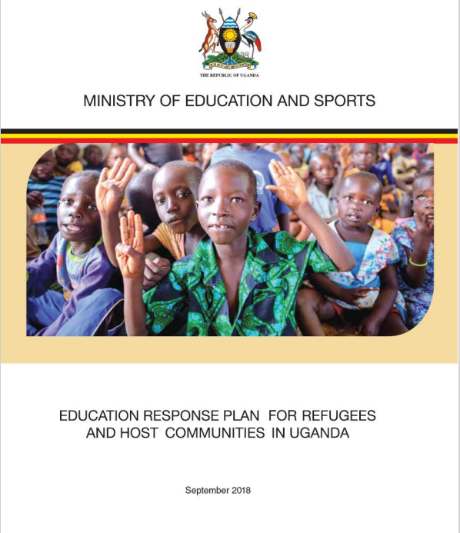
Promising examples
Uganda Education Response Plan (ERP)
Developed under the leadership of the Ministry of Education in close cooperation with humanitarian and development partners.
The Plan sets out how all refugee children, as well as host community children, can have access to quality learning.
It is a paradigm shift from a mainly humanitarian focus to developing integrated services for the long term for both refugee and host community children
Notes:
Uganda:
Uganda hosts the largest number of refugees in Africa, and is one of the top refugee-hosting countries worldwide. The refugee hosting districts are among the least developed in the country, and the additional influx is putting a severe strain on already limited resources. Schools – many of which are already facing challenges of poor infrastructure and shortage of teachers – are under increasing pressure. Some classrooms have more than 200 learners, with no walls or basic sanitation, and there is a shortage of books, desks and basic materials. This has a significant negative impact on the quality of learning.
To address these huge needs, the Education Response Plan (ERP) for Refugees and Host Communities in Uganda has been developed under the leadership of the Ministry of Education in close cooperation with humanitarian and development partners. This Plan – the first of its kind – shows how an average of 567,500 learners per year can be reached with improved education services, at a total cost of USD 389 million between 2018 and 2021.
The Plan sets out how all refugee children, as well as host community children, can have access to quality learning. It is a paradigm shift from a mainly humanitarian focus to developing integrated services for the long term for both refugee and host community children. It advocates for predictable and sustainable financing for this emergency and protracted crisis and aspires to bridge humanitarian response with sustainable development.
3. Niger: villages d'opportunités
Another example is the work done in Niger on the “villages d'opportunités” (villages of opportunity), where UNHCR worked with humanitarian and development actors in both Niger and Nigeria to strengthen basic services in the Maradi region of Niger. By mapping regional needs and identifying ‘relocation villages’, actors developed a plan to distribute resources between host villages and relocation villages. As a result, host communities have strengthened their capacity to absorb new arrivals and without added pressure on existing services, a peaceful coexistence between communities has been maintained.
By January 2022, 3.972 (17.713 individuals) were relocated to three different villages of opportunities
4. South Sudan: Pockets of Hope
Refugee camps and counties to which refugees are returning can represent pockets of hope, places where people are making peace, and where money spent is money invested in the peaceful, green future of South Sudan. Together with South Sudan government and international partners, UNHCR is modelling a pocket of hope approach that takes as a starting point refugee and returnee agency, and as its end-point areas where all people regardless of status have a chance at integration and economic progress.
Enabling refugees and internally displaced to sustain themselves, will not only allow them to give back to host communities, but support their eventual return and cement the path to peace. Investing in South Sudan’s future will pay long-term dividends not only for refugees, South Sudanese but also the wider region.

Slide 13
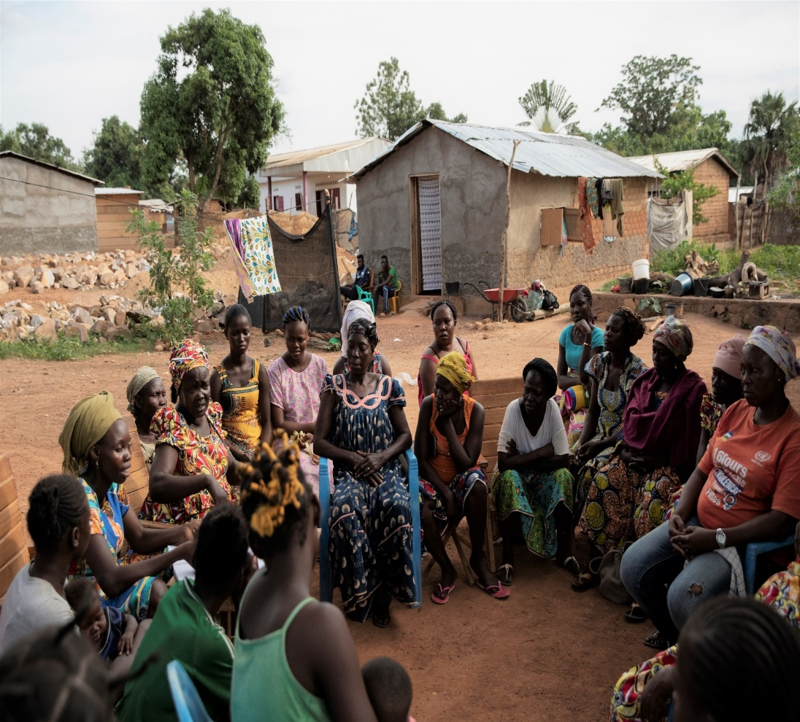
Promising examples
Niger: Village d’opportunités
Following displacement of the conflict in north-western Nigeria, 80,000 people forced to flee to the Maradi region in Niger for more than two years
Relocation of refugees away from the border to ensure safety, while easing pressure from host communities to ‘relocation villages’
UNHCR worked with humanitarian and development actors in both Niger and Nigeria to strengthen basic services in the Maradi region of Niger for refugees and host communities
Notes:
Niger: villages d'opportunités
Another example is the work done in Niger on the “villages d'opportunités” (villages of opportunity).
For more than two years, conflict in north-western Nigeria has forced more than 80,000 Nigerians to flee to the Maradi region in Niger. In addition, repeated intrusions of armed bandits on the Nigerien territory have triggered internal displacement of around 26,000 people. Armed criminal gangs operate regularly on both sides of the border mainly targeting farmers and breeders and conduct kidnapping with the objective of ransom.
The overall strategic direction of UNHCR’s response in Maradi is to relocate refugee communities away from the border to ensure their safety, while at the same time, easing the pressure from the host communities.
Subsequently, sites have been built in nearby rural villages and services were reinforced for both, the refugee - as well as the host communities, such as access to water, health services, education, and protection assistance.
UNHCR worked with humanitarian and development actors in both Niger and Nigeria to strengthen basic services in the Maradi region of Niger. By mapping regional needs and identifying ‘relocation villages’, actors developed a plan to distribute resources between host villages and relocation villages. As a result, host communities have strengthened their capacity to absorb new arrivals and without added pressure on existing services, a peaceful coexistence between communities has been maintained.
UNHCR has relocated 3,972 households of 17,713 individuals far away from their first entry points to safe and to secured villages where protection services are available. Thus, UNHCR has relocated Nigerian refugees to three “villages of opportunity”. These include 7,919 refugees in Chadakori: 5,434 in Dan Dadji Makaou and 4,360 in Garin Kaka. But recent regional authority measure suspended the relocation process until further notice.

Slide 14
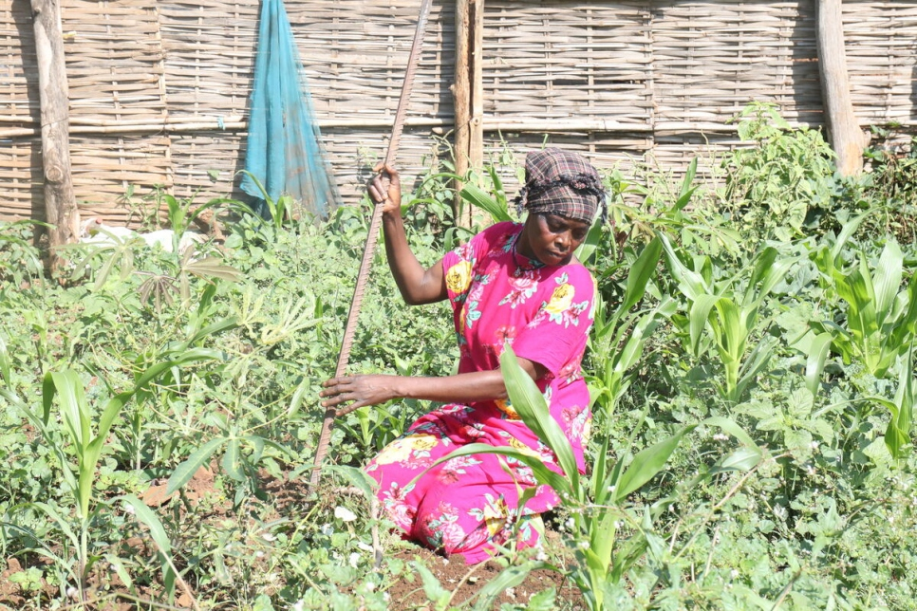
Promising examples
South Sudan: Pockets of Hope
UNHCR supports the reintegration of those refugees who have decided to return with community-focused investment in areas of return.
The approach is being described as “pockets of hope” and is in line with South Sudan’s National Plan on Return, Relocation and Reintegration of Displaced Persons.
Regina Ochala, 42, tends to her garden in Juba, South Sudan, where she returned in July 2021 following two decades of displacement in Sudan. © UNHCR/Gift Friday Noah
Notes:
South Sudan: Pockets of Hope
While UNHCR is not yet in a position to facilitate voluntary repatriation, conditions in some areas are such that UNHCR in South Sudan works to stabilize the return and support the reintegration of those refugees who have decided to return with community-focused investment in areas of return.
The approach is being described as “pockets of hope” and is in line with South Sudan’s National Plan on Return, Relocation and Reintegration of Displaced Persons.
Refugee camps and counties to which refugees are returning can represent pockets of hope, places where people are making peace, and where money spent is money invested in the peaceful, green future of South Sudan.
Together with South Sudan government and international partners, UNHCR is modelling a pocket of hope approach that takes as a starting point refugee and returnee agency, and as its end-point areas where all people regardless of status have a chance at integration and economic progress.
Enabling refugees and internally displaced to sustain themselves, will not only allow them to give back to host communities, but support their eventual return and cement the path to peace. Investing in South Sudan’s future will pay long-term dividends not only for refugees, South Sudanese but also the wider region.

Slide 15
Thank You!

